Slide 1
Resiliency -Promoting Healthy Transitions
Barbara L. Hale-Richlen M.D.
Child, Adolescent and Adult Psychiatrist

Slide 2
Vulnerability of Transition Years
Preschool
Grade School
Middle School
Junior High School
High School
College

Slide 3
Skills and attributes gained from life experiences and healthy relationships. Aids problem solving, dealing with challenges and recovering from disappointments.
Resiliency

Slide 4
How to promote Resiliency?
Enhance the normal developmental process
Temperament
Parenting styles
Normal child development
Foster developmentally appropriate problem solving tools

Slide 5
Temperament
A child's reaction and approach to the world
Personal style
Involves many different traits
Helps identify strengths and needed supports
Intensity varies
Influenced by parenting styles, culture, environment
"Goodness of fit"
Understanding helps anticipate & avoid issues

Slide 6
Temperament
Thomas and Chess - Nine behaviors
Activity level
Rhythmicity (regularity)
Approach or withdrawal
Adaptability
Threshold of responsiveness
Intensity of reaction
Quality of mood
Distractibility
Attention span and persistence

Slide 7
Easy or Flexible - 40% Active or Feisty (Difficult) - 10% Slow to Warm Up or Cautious - 15%
Temperament - 65%

Slide 8
Easy or Flexible Temperament
Characteristics Supports
Positive approach
Regular pattern of eating, sleeping, etc
Ability to tolerate frustration
Adaptable to change
General good mood
Consistency across environments
Positive reinforcement
Check in and initiate communication
Encourage help seeking when needed

Slide 9
Active or Feisty Temperament
Characteristics Supports
Irregular patterns
Negative approach
Temper tantrums when frustrated
Loud refusal, oppositional or aggressive behaviors
Need more time
Prepare for transitions
Get down to their level
State clear expectations
Acknowledge their emotions
Stay calm
Reassurance and positive feedback

Slide 10
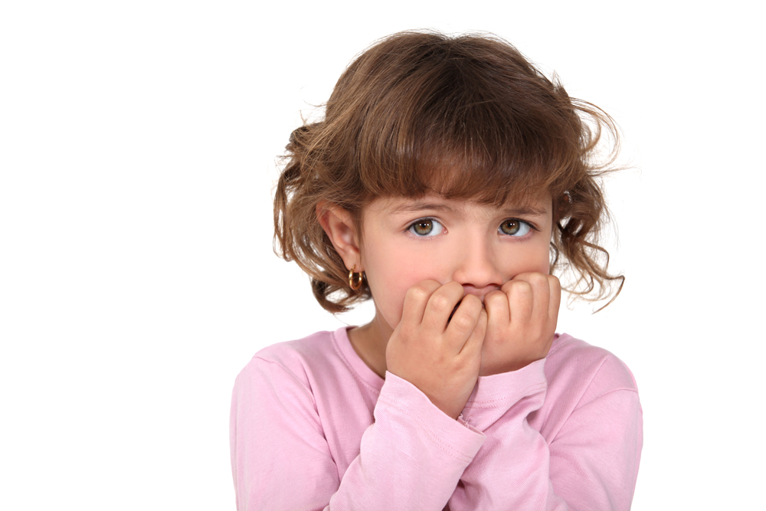
Slow to Warm Up or Cautious Temperament
Characteristics Supports
Mildly negative response
Fairly regular patterns
Repeated exposures help acceptance
May withdraw, cling, refuse to move or retreat
Predictable environment
Clear routine
Give them time
Observe for cues of distress
Verbalize support and encouragement

Slide 11
Parenting Styles
Diana Baumrind - (1960's) identified four important dimensions of parenting
Discipline
Warmth and Nurturance
Communication Styles
Expectations of Maturity and Control

Slide 12
Demandingness Responsiveness
"Level of parental expectations placed on the children in regard to behavior regulation and maturity."
Baumrind, 2005
"Extent to which parents foster individuality with supportiveness and warmth."
Baumrind, 2005

Slide 13
Authoritarian - 'Dictatorial' Authoritative - 'Democratic' Permissive - 'Friend' Uninvolved - 'Laissez Faire'
Four Parenting Styles
Permissive
Uninvolved

Slide 14
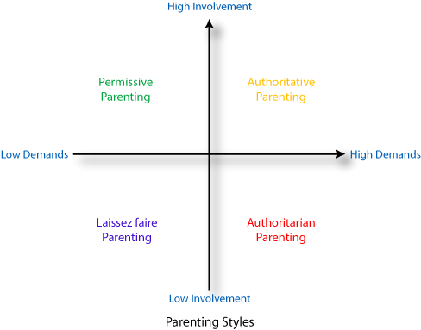
Based on 'Demandingness' and 'Responsiveness'

Slide 15
Authoritarian
Obedience oriented
Highest control
Low warmth
High demands
Little communication
Punitive discipline

Slide 16
Authoritarian
Lower in happiness, social competence and self-esteem
Increased anxious and withdrawn behaviors
Lack self-reliance
Rely on authority figures to make decisions
Reduced intrinsic motivation
Negative association with academic achievement
Baumrind 1971, 1967 Rogers et al., 2009
Developmental outcomes:

Slide 17
Authoritative
Assertive
Not intrusive or restrictive
High demands
High response
High communication
Balances discipline and individuality
Work through problems as a team

Slide 18
Authoritative
Most strongly correlated with student achievement
Steinberg et al., 1992
More positive about school
Intrinsically motivated
More confident with decision making
Less anxiety with transitions
Developmental outcomes:

Slide 19
Permissive
Indulgent
Low expectations of maturity and self control
Low demands
High response
High communication
Punnishment rarely used
Children make their own decisions

Slide 20
Permissive
Reduced social competence
Less self reliant
Less able to tolerate frustration
Lack intrinsic motivation
Social issues - bullying or being bullied.
Negative association with academic achievement
Baumrind 1971, 1967 Dornbusch et al., 1987
Developmental outcomes:

Slide 21
Uninvolved
Detached
Low Demands
Low Response
Little communication
Respond when urgent or out of annoyance
Low levels of warmth and control

Slide 22
Uninvolved
Lack direction
Negative attention seeking
Little motivation for academics
43% of all parents never participate in school activities
Steinberg et al., 1992
Developmental outcomes:

Slide 23
Normal Development - Preschool 3 - 5 years old
Internal
External
Notice world outside of home
Like to explore
Want independence
Beginning to play with peers
Require reassurance and encouragement
Motor skills
Ride a tricycle
Dress and undress
Notice differences between sexes
Help with simple chores

Slide 24
Transitions - Preschool
Read to your child
Simple chores build confidence
Encourage play with other children
Clear and consistent discipline
Explain new situations
State what behavior is expected
Teach safe behaviors around strangers

Slide 25
Transitions - Preschool
Speak in complete sentences
Use proper words
Limit screen time to less than 2 hours a day
Give limited number of simple choices
Help them through the steps to solve problems
Positive praise

Slide 26
Normal Development - Grade School 6 - 9 Years Old
Internal
External
Sense of body image
Concern for others
Fear of being teased
Peer acceptance
"Trying on" behaviors
Physical development
Cognitive development
6 yo - 15 min, 3 step command
9 yo - 60 min, 5 step command
Frustration or anxiety with school
Somatic symptoms

Slide 27
Transitions - Grade School
Clear rules for bedtime, TV, social media, etc
Have your child read to you
Household chores build responsibility
Set achievable goals
Encourage them to try new challenges
Model behaviors you want to develop
Talk about school, friends and what's important to them

Slide 28
Transitions - Grade School
Involvement at school - meet teachers and friends
Discipline to guide and protect - not punish
Practice patience and use praise
Family activities - events, playing games, meals, etc
Encourage joining school and community groups

Slide 29
Normal Development - Middle School 10 - 12 years old
Internal
External
Sense of identity
Feeling awkward
Alternating between high expectations and low self-esteem
Worries about being "normal"
Stronger, more complex friendships
Susceptible to bullying
Growing influence from peers
Moodiness
Challenging to parents
Less affectionate or rude
Revert to childish behaviors when stressed

Slide 30
Transitions - Middle School
Increased peer pressure
School becomes more challenging
Stay involved - school, social media, friends and friend's parents
Continue dialogue about their interests, activities, etc
Encourage them to set goals
Begin to see other's points of view

Slide 31
Transitions - Middle School
Discuss alcohol, smoking, drugs, dating, etc
Body image, SIB and eating issues sometimes emerge
More independence from family
Clear rules for behavior when adults are not present
Increased responsibility at home - cooking, cleaning, etc

Slide 32
Normal Development - Jr. High 13 - 14 years old
Internal
External
Concerns over appearance & attractiveness
Sensitive to social standing
Increased interest in sex
Vulnerable to peer pressure
More challenging school work
May feel sadness or depression
Focus on friendships
Less time with family
Intellectual interests expand
Greater ability for physical, mental and emotional work
Still see impulsivity and immaturity
Present oriented

Slide 33
Transitions - Jr. High School
Sadness or depression - poor grades or risk taking behaviors
Intensified concern for body image, clothing, etc.
Monitor eating issues
Stress kindness and inner beauty
Volunteering or charity work

Slide 34
Transitions - Jr. High School
Continued involvement at school and with friends/families
Continue discussion about rules, expectations, drugs, smoking, drinking, sex, social media
Clear consequences when rules are broken
Respect their opinions
Listen and validate their emotions

Slide 35
Normal Development - Early High School 15-16 years old
Internal
External
Own ideals/role models
Firmer sense of identity
Ability to think things through
Peer relationships more balanced
Want more independence
Improved independent functioning
Increased emotional stability and self reliance
Increased concern for others

Slide 36
Normal Development - Late High School 17 - 18 years old
Internal
External
Concern for the future
Importance placed on their role in life
Feelings of more mature love
Firmer sense of sexual identity
Work habits more defined
Development of more serious relationships
Setting own goals
Decreasing conflicts with parents

Slide 37
Transitions - High School
Continued risk for alcohol, drugs, risky behaviors, etc
Anxiety may increase as graduation nears
Continue to monitor eating, mood & behavior changes
Frank discussions about sadness, depression, thoughts of suicide

Slide 38
Transitions - High School
Continued involvement at school and with friends/families
Encourage involvement in sports, music, theater, arts, etc
Show affection and spend time together
Respect and listen to their opinion
Encourage problem solving

Slide 39
When transitions don't go smoothly...
Learning Disabilities
ADHD
Depression
Anxiety
Divorce
Substance Abuse
Bullying
Social Media
Health problems
When to ask for help?

